Slide 1
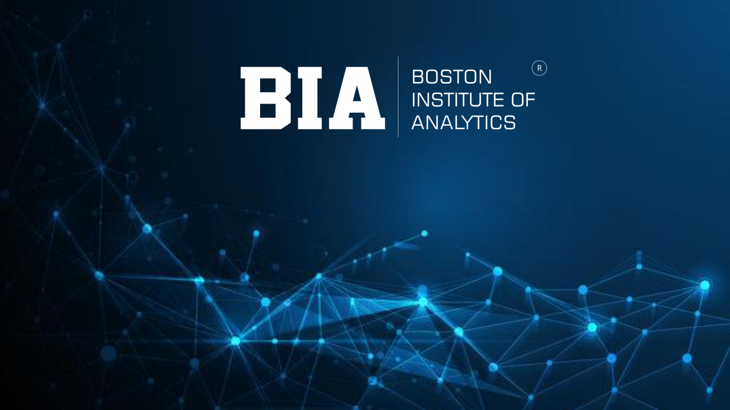

E-commerce Customer Segmentation and Prediction
By Ritesh Kumar
information document belongs Boston Institute of Any unauthorized sharing of this
subject under of IP and confidentiality .

Slide 2
Project Overview:
1.Introduction
2. Dataset Overview & Cleaning
3. RFM Feature Engineering
4. Exploratory Data Analysis (Graphs)
5. Outlier Handling & Scaling
6. Customer Segmentation (K-Means + Others)
7. Segment Interpretation (VIP, Loyal, etc.)
8. Prediction Model (Random Forest)
9. Streamlit App
11. Conclusion
12.Recomendation
13.Future Scope
CONFIDENTIAL: The information in this document belongs to Boston Institute of Analytics LLC. Any unauthorized sharing of this material is prohibited and subject to legal action under breach of IP and confidentiality clauses.

Slide 3
Introduction
Objective:
Develop a robust customer segmentation model using clustering methods (K-Means, Hierarchical, DBSCAN).
Predictive classifier to categorize customers based on purchasing behavior.
Enable tailored marketing strategies, improved customer retention, and optimized inventory management.
Project Overview:
Focus on understanding customer purchase patterns.
Segment customers and predict future behavior using machine learning.
Goal: actionable insights for marketing and retention.
Benefits
Enhanced customer segmentation → targeted marketing.
Cost efficiency → focus on high-value segments.
Improved customer satisfaction → personalized offers and communication.
CONFIDENTIAL: The information in this document belongs to Boston Institute of Analytics LLC. Any unauthorized sharing of this material is prohibited and subject to legal action under breach of IP and confidentiality clauses.

Slide 4
Deliverables
Documented ML model for segmentation.
Explanation of model, features, and preprocessing.
Methodology
Exploratory Data Analysis (EDA) to understand behavior.
Compare multiple clustering methods (K-Means, Hierarchical, DBSCAN).
Feature importance analysis (Recency, Frequency, Monetary).

Slide 5
WORK FLOW
Data Collection / Dataset
Data Preprocessing
Exploratory Data Analysis
Feature Engineering
Clustering Methods
Cluster Interpretation & Segmentation
Split Train And Test Data
Model Selection and
Model Training
Deployment

Slide 6
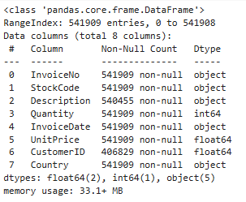
Dataset overview
This dataset consist of transaction –level data collected fron a reatil store.
There are 541909 rows and 8 columns containing details about purchases made by customer.
Data Source:
The data is stored in CSV file (data.csv),with columns like Invoice No, StockCode Description, Quantity, InvoiceDate,UnitPrice, CustomerID, Country.

Slide 7
Key Columns
InvoiceNo : A unique identifier assigned to each invoice, representing a transaction of order.
StockCode : A unique product code assigned to items sold , enabling product identification and tracking.
Description : Provides details about the product ,aiding in understanding its nature and purpose.
Quantity : Specifies the number of items purchased or returned in a transaction. Negative values indicates returns.
InoviceDate : Records the exact date and time when a transaction occurred, useful for time-based analysis.
Unit Price : Represents the price per unit of a product in the transaction. Used to calculate sales revenue.
CustomerID : A unique identifier for each customer, useful for tracking buying behaviour and segmentation.
Country : Indicates the geographical location of the customer, helping in regional sales analysis.

Slide 8

Data Cleaning and Preprocessing
Handling Missing Values :
The dataset contained missing values in:
Description column → 1,454 missing entries
CustomerID column → 135,080 missing entries
Rows with missing CustomerID were removed because customer identification is essential for RFM analysis.
This reduced the dataset from 541,909 rows → 406,829 rows.
Data Type Conversion:
The CustomerID column was converted from a float type to a string for better processing and to main consistency.
Handling Invalid Transactions
Removed transactions where Quantity ≤ 0, as negative values indicate returns or errors.
Fixing Date Format
Converted InvoiceDate to a proper datetime format using errors='coerce'.
This ensures accurate calculation of Recency.
Removing Duplicate Records
Duplicate rows were dropped to maintain data consistency and avoid double counting.
Adding Monetary Value
Created a new feature TotalPrice = Quantity × UnitPrice.
This represents the monetary value of each transaction, required for RFM analysis.
After all cleaning steps, the dataset was reduced to:
392,732 rows × 9 columns

Slide 9
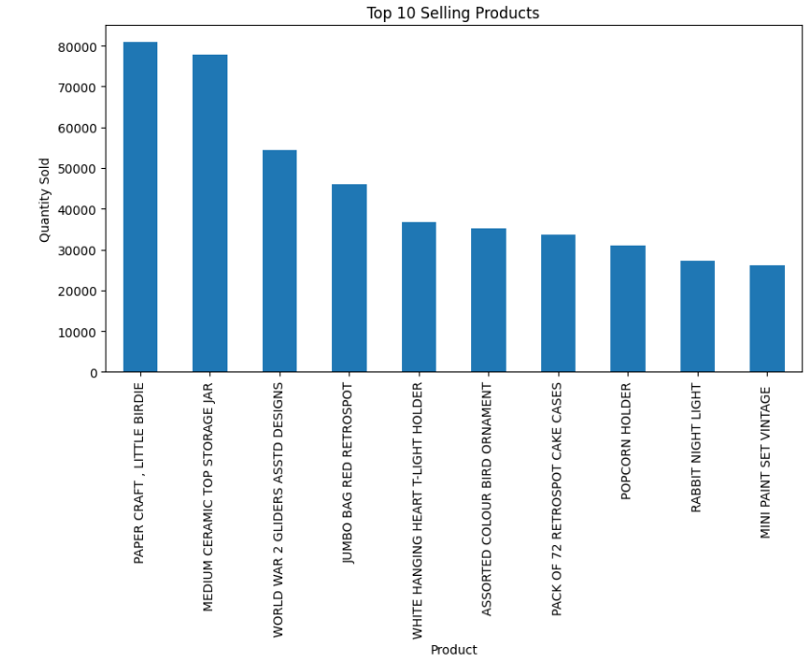
EDA:
Top 10 Best-Selling Products:
This bar chart shows the highest-selling products based on total quantity purchased.
"PAPER CRAFT, LITTLE BIRDIE" is the top-selling item with over 80,000 units sold.
Many top products are low-cost, high-volume gift items, indicating strong demand in small decorative products.
Helps identify inventory priorities and fast-moving items.

Slide 10
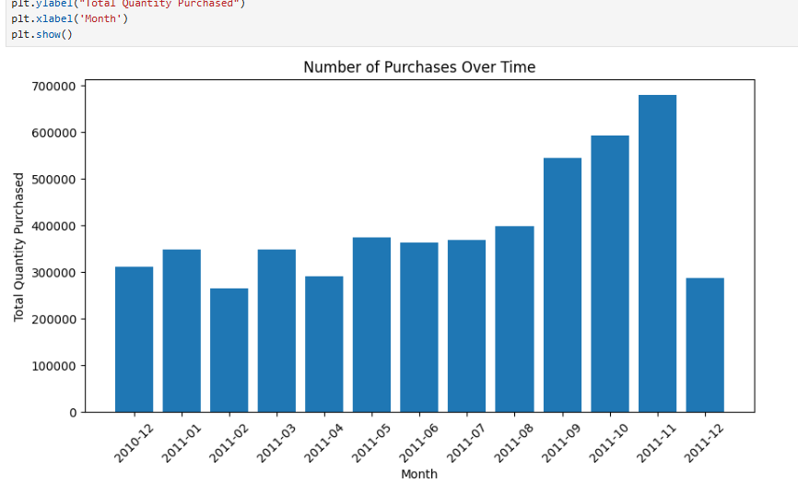
Monthly Purchase Trend:
Shows month-wise total quantity purchased between 2010–2011.
Clear rise in purchasing activity toward the end of 2011.
Biggest spike observed in November 2011, suggesting seasonal trends (holiday shopping).
Helps organizations in seasonal forecasting, stock planning, and marketing campaigns.

Slide 11
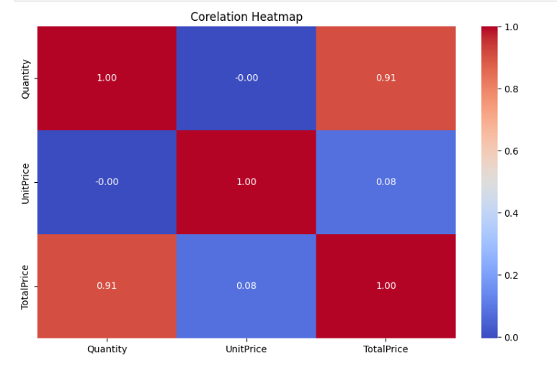
Correlation Analysis:
Strong positive correlation (0.91) between Quantity and TotalPrice.
Weak/negative correlation between Quantity and UnitPrice, meaning expensive items are bought in smaller quantities.
Helps understand which variables influence revenue the most before modeling.

Slide 12
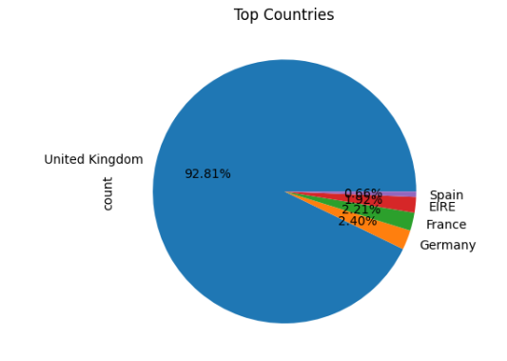
Country-Wise Customer Distribution:
The UK accounts for 92% of all transactions, showing this dataset is heavily dominated by UK customers.
Other countries like Germany, France, EIRE contribute very small percentages.
Analysis and segmentation will primarily focus on UK customers due to large sample size.

Slide 13
RFM Analysis for Customer Segmentation:
RFM Analysis
Recency, Frequency, Monetary –(RFM)Analysis
RFM Metrices:
Recency : Day’s since the customer’s last purchase.
Frequency : Number of purchases by the customer.
Monetary : Total amount spent by the customer.
Objective: Identify and segment customers for personalized marketing and engagement.
Monetary :
The total amount spent by a customer.
It helps identify high-value customers based on spending.
Multipy the Quantity and UnitPrice for each transaction .
Aggregate the spending for each CustomerID.

Slide 14
Frequency:
The number of transactions a customer made during the timeframe .
High-freuency customers indicate loyalty and engagement.
Count the unique invoices for each coustomerID.
Recency:
The number of days since a customer’s last transaction.
Recent purchases suggest higher likelihood of repeat purchases.
Calculate the difference between max_date (last transaction date in the dataset) and each customer’s InvoiceDate.
Extract the number of days for comparison.

Slide 15
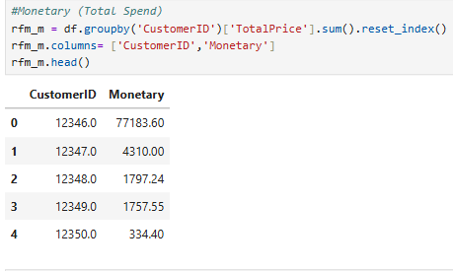
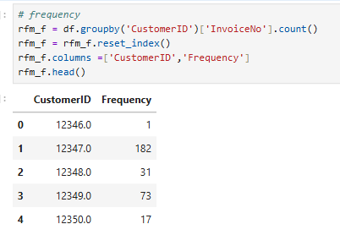
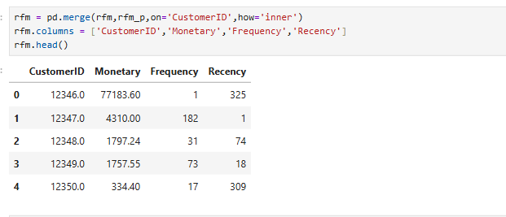
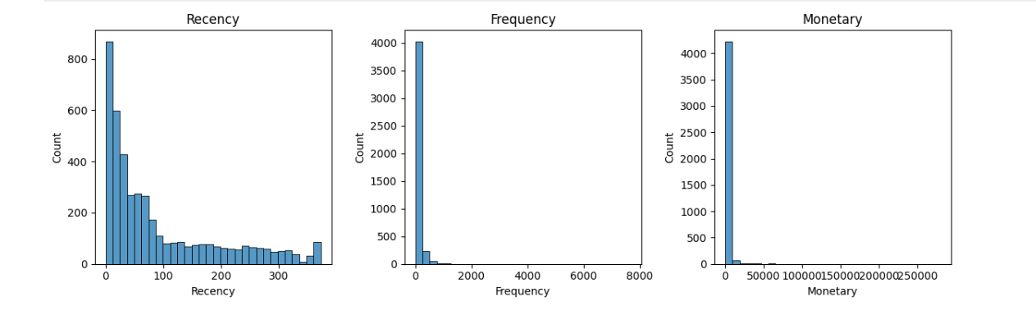

Slide 16
Outlier Analysis of Amount, Frequency, and Recency:
Introduction to Outlier Analysis
Outlier analysis identifies data points that deviate significantly from the normal pattern. These unusual values may represent errors, rare events, or unique customer behaviors, and must be investigated for better data quality.
Purpose of Analyzing Outliers
1. Improving Data Quality
Removing or treating outliers helps eliminate noise.
Ensures the dataset is clean and reliable for analysis.
2. Enhancing Customer Segmentation
Outliers in Monetary, Frequency, and Recency may represent exceptional customers (very high spenders or extremely inactive customers).
Helps in creating more meaningful RFM segments.
3. Improving Model Accuracy
Outliers can distort clustering and predictive models.
Proper handling ensures more accurate and stable results.

Slide 17
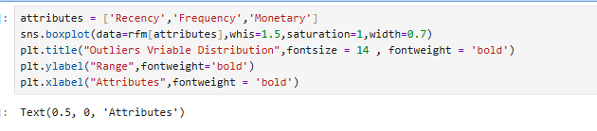
Attributes Analyzed:
We perform outlier analysis on the following key RFM attributes:
Amount (Monetary): Total value spent by the customer.
Frequency: Number of transactions made by the customer.
Recency: Time elapsed since the customer's last purchase.

Slide 18
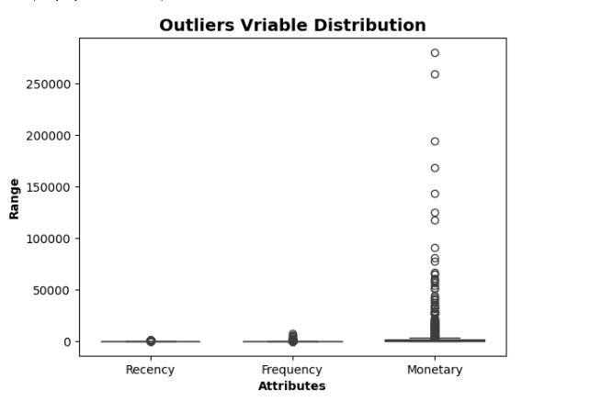
Visualizing Outliers with Box Plots:
To detect outliers, we used box plots. A box plot is an effective way to visualize the distribution of data and highlight outliers.
Whiskers: Represent the range of data within 1.5 * Interquartile Range (IQR). Data beyond the whiskers are considered outliers.
Boxes: Represent the interquartile range (IQR), which is the middle of data.

Slide 19
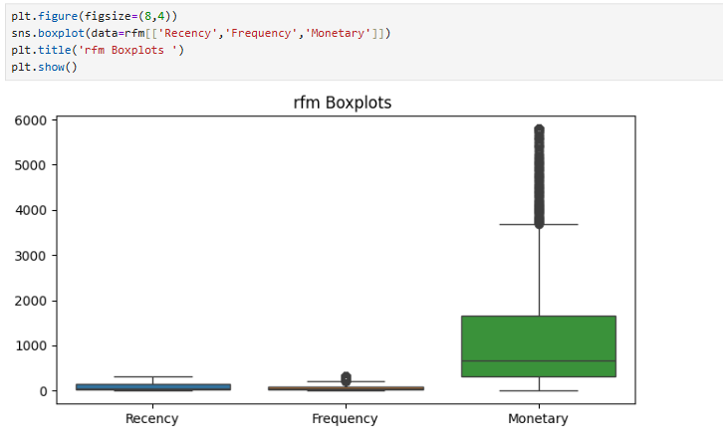
RFM Boxplot –
Recency
The box is very small, indicating most customers purchased recently.
A few points far above the box represent inactive customers (outliers).
Frequency
Most customers purchased only 1–2 times, shown by the compressed lower box.
Several points above the box indicate loyal, repeat customers (outliers).
Monetary
Monetary values are highly right-skewed.
Many high-value outliers show the presence of premium customers, but they are very few.

Slide 20


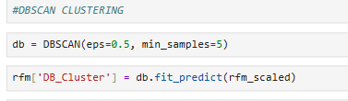
Customer Segmentation :
Different clustering method are used Like K-Means ,Hierarchical clustering and DBSCAN clustering etc.
From the above I choose K-Means for the segmenting the customers because its,simple efficient and scale well to large datasets.

Slide 21
Clustering –
Definition: Clustering is a machine learning technique that groups similar data points based on their features.
Purpose:
• Organize data into meaningful structures
• Identify hidden patterns, trends, or customer groups
• Simplify complex datasets for easier analysis and decision-making.
Why Are We Using Clustering?
• Customer Segmentation: Understand customer behavior by grouping customers with similar purchasing patterns.
• Tailored Marketing: Create targeted marketing strategies for each customer segment.
• Data Simplification: Reduce dataset complexity by representing data through clusters.
• Anomaly Detection: Find unusual behaviors or outliers in data.

Slide 22
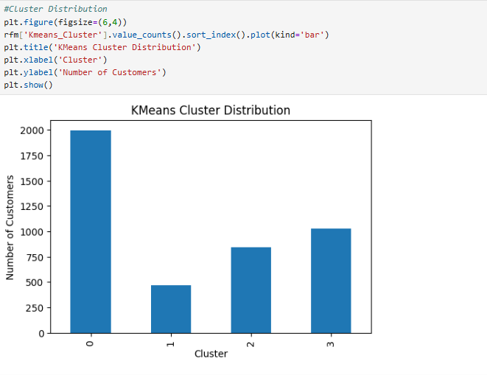

Slide 23
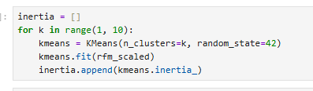
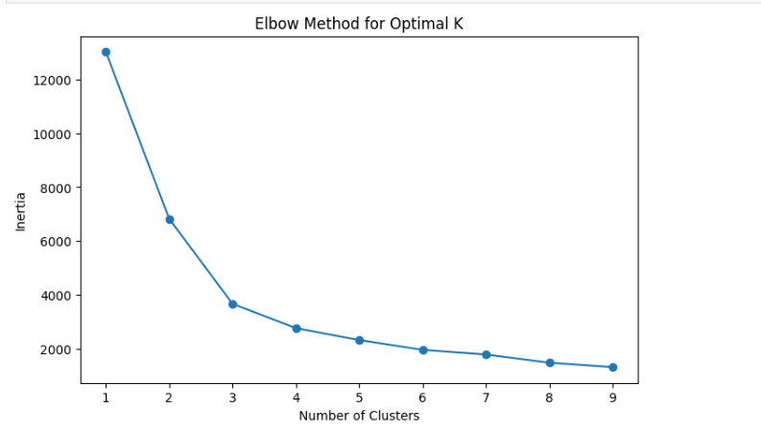
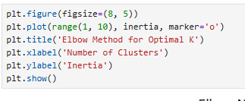
Determinig the optimal number of clusters – Elbow Method
Elbow Curve : Used to determine the optimal number of clusters by plotting the inertia for different values of k.
The “elbow” of the curve shows the optimal number of clusters.

Slide 24
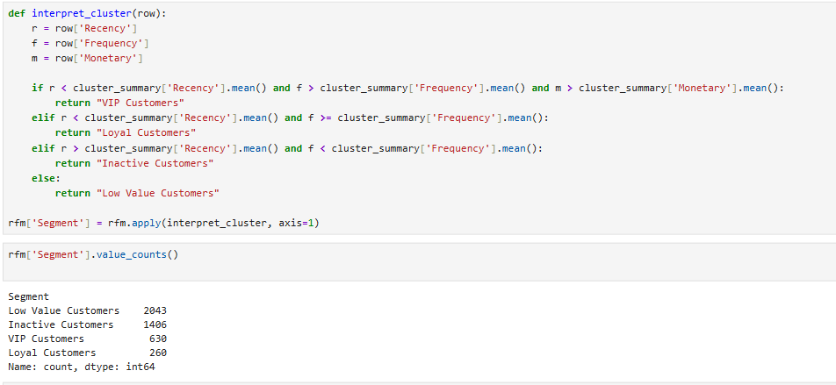
Customer Segmentation Based on RFM:
“Customers are segmented into meaningful groups based on their Recency, Frequency, and Monetary values.”
“Segmentation helps in identifying high-value, loyal, inactive, and low-value customers for targeted marketing.”
VIP Customers: Recent purchase is high (low Recency), frequent purchase, high monetary value.
Loyal Customers: Recent purchase is high (low Recency), frequent purchase, monetary value moderate.
Inactive Customers: Haven’t purchased recently (high Recency), low frequency.
Low Value Customers: Customers who do not fit in above categories (low frequency, low monetary value).

Slide 25
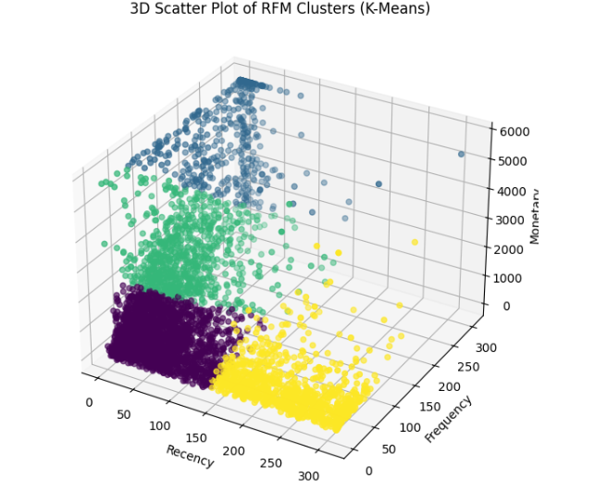
3D Scatter Plot of RFM Clusters:
“This 3D scatter plot visualizes customers based on Recency (R), Frequency (F), and Monetary (M) values.”
“Different colors represent different K-Means clusters.

Slide 26

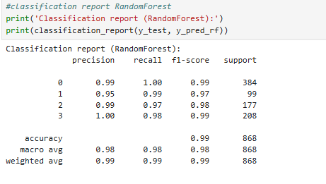
Model Prediction :
For prediction we can use different models, here I have used logistic regression, Decission Tree,Random Forest.
The accuracy of the models:
Random Forest achieved the highest accuracy and most reliable predictions.Now we choose Random forest.

Slide 27
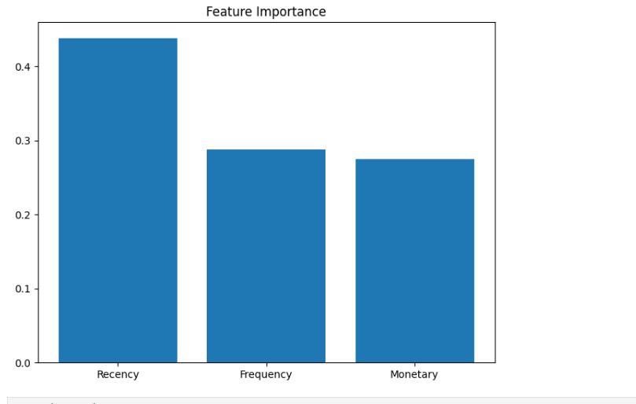
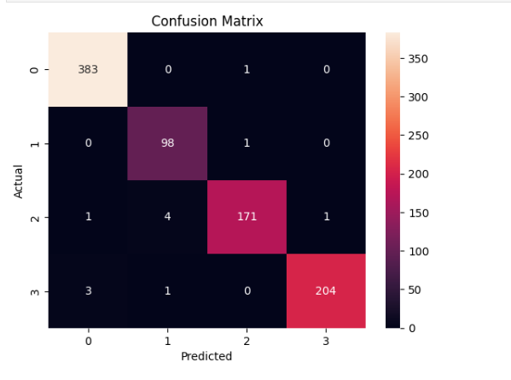
Confusion matrix:
Hyperparameter Tuning:
Current model:
Random Forest Accuracy: 98% Further improvement is possible by tuning parameters like n_estimators, max_depth, or min_samples_split, but current model already performs excellently.*

Slide 28
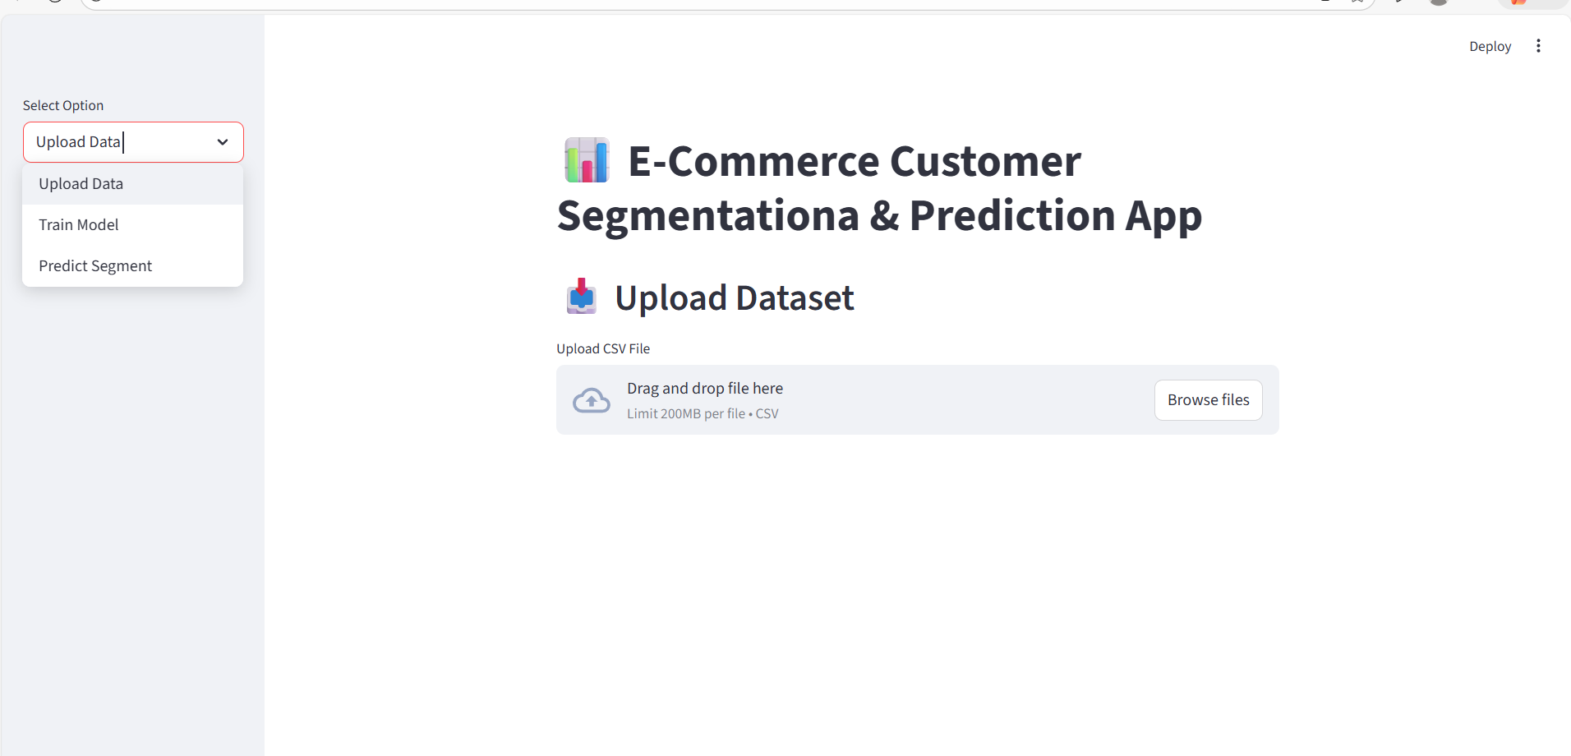
E-Commerce Customer Segmentation and Prediction App (Streamlit Deployment):
App functionality:
Upload Data (CSV)
Train Model (calls load_data(), create_rfm(), preprocess_rfm(), train_kmeans())
Predict Segment (enter Recency, Frequency, Monetary → model.predict)

Slide 29

Conclusion:
Our e-commerce customer segmentation and prediction analysis provides powerful insights that help improve business revenue, customer retention, and overall operational efficiency.
High-value customers are identified and can be targeted with loyalty programs and exclusive offers.
Medium-value customers can be encouraged to increase their spending through personalized recommendations and upselling strategies.
Low-value or inactive customers can be re-engaged using targeted campaigns to boost their purchase activity.
Behavioral insights from Recency, Frequency, and Monetary scores enable accurate identification of loyal, active, and high-spending customers.
Predictive modeling helps forecast future customer behavior, enabling proactive marketing, retention planning, and better decision-making.
Inventory optimization becomes easier by predicting top-selling products and demand trends, helping avoid stockouts and overstock situations.
Marketing efficiency improves as targeted campaigns ensure better ROI by focusing on the most promising customer groups.
belongs to Boston Institute of Analytics LLC. Any unauthorized sharing of this under breach of IP and confidentiality clauses.

Slide 30
Recommendations:
Retain High-Value Customers
Offer loyalty programs, exclusive discounts, and early-access benefits.
Use the prediction model to identify high-value customers at risk of churn and send targeted retention incentives.
Increase Medium-Value Customer Spending
Use personalized product recommendations and bundle offers.
Run targeted promotions to increase purchase frequency and encourage repeat buying.
Re-Engage Low-Value / Inactive Customers
Launch email/WhatsApp reactivation campaigns with strong promotional offers.
Use predictive scores to identify customers with a higher probability of returning.
Optimize Inventory Based on Predictions
Maintain sufficient stock for predicted high-demand products.
Apply promotional bundles, combo offers, or clearance strategies for slow-moving SKUs.
Improve Marketing Return Of Investment(ROI)
Run customized marketing campaigns for each customer segment to reduce wasted ad spend.
Focus budget on high-value and high-likelihood buyers to maximize return on investment.
Enable Personalized Customer Experience
Use RFM scores and prediction results to display personalized product lists on the website/app.
Send targeted notifications and emails to significantly improve conversions.
CONFIDENTIAL: The information in this document belongs to Boston Institute of Analytics LLC. Any unauthorized sharing of this material is prohibited and subject to legal action under breach of IP and confidentiality clauses.

Slide 31
Future Scope:
1. Explore More Advanced Clustering Techniques
More advanced clustering methods can be explored to achieve deeper and more meaningful customer segmentation.
2. Improve Prediction Accuracy With Advanced ML Approaches
Future work can include testing more advanced machine learning techniques to further improve prediction accuracy.
3. Add Additional Customer Behaviour Features
Incorporating browsing history, click patterns, and customer lifetime value can make the prediction model more comprehensive.
4. Implement Real-Time Model Monitoring
In the future, continuous model evaluation can be added to analyze how the model performs with new data and to understand changes in customer behavior over time.
5. Enhance the Recommendation Experience
A more advanced recommendation engine can be developed using segmentation + prediction results to provide personalized product suggestions.
6. Automate Marketing Workflows
Marketing actions such as sending offers, emails, and notifications can be automated based on customer segments and predicted behavior.

Slide 32
Questions?
CONFIDENTIAL: The information in this document belongs to Boston Institute of Analytics LLC. Any unauthorized sharing of this material is prohibited and subject to legal action under breach of IP and confidentiality clauses.

Slide 33

Thank You!
information document belongs Boston Institute of Any unauthorized sharing of this
subject under of IP and confidentiality .

